Slide 1
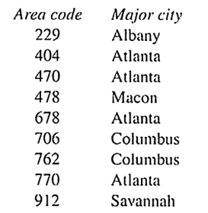
WEEK5 LAB
1. 下列表达式的值是多少？
What is the numerical value of each of the following expressions?
a. 5 > 2
b. 3 + 4 > 2 && 3 < 2
c. x >= y || y > x
d. d = 5 + ( 6 > 2 )
e. 'X' > 'T' ? 10 : 5
f. x > y ? y > x : x > y
2. 下表展示了Georgia州的电话区号以及每个地区中最大的城市：
The following table shows telephone area codes in the state of Georgia along with largest city in each area:
编写一个switch语句，其控制表达式的变量是area_code。如果area_code的值在表中，switch语句将打印相应的城市名称。否则，switch语句将显示“区号不被识别”。
Write a switch statement whose controlling expression is the variable area_code. If the value of area_code is in the table, the switch statement will print the corresponding city name. Otherwise, the switch statcment will display the message "Area code not recognized".

Slide 2
3.下面的程序具有不必要的复杂关系表达式以及一些错误。简化并纠正它。
The following program has unnecessarily complex relational expressions as well as some outright errors. Simplify and correct it.
#include <stdio.h>
int main(void)
{
int weight, height; // weight in lbs, height in inches
scanf("%d, weight, height);
if (weight < 100 && height > 64)
if (height >=72)
printf("You are very tall for your weight.\n")
else if (height < 72 && > 64)
printf("You are tall for your weight.\n")
else if (weight > 300 && ! (weight <= 300))
&& height < 48)
if (!(height >= 48))
printf("You are quite short for your weight.\n")
else
printf("Your weight is ideal.\n")
return 0;
}

Slide 3
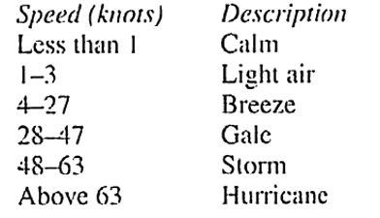
4. 编写一个程序允许用户输入两个日期，然后判断哪个日期在日历中更早。
Write a program that prompts the enter two dates and indicates which date comes earlier on the calendar.
Enter first date (mm/dd/yy): 3/6/2008
Enter second date (mm/dd/yy): 5/17/2007
5/17/2007 is earlier than 3/6/2008
5. 下面是一个简化的Beaufort风级，用于估算风力。编写一个程序，要求用户输入风速(以节为单位)。然后显示相应的描述信息。
Write a program that asks the user to enter a wind speed (in knots), then displays the corresponding description.

Slide 4
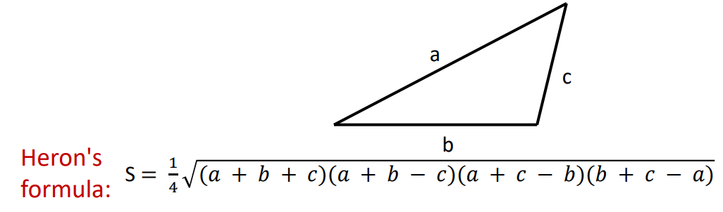
6. 编写一个程序读入三角形的三条边，输出他的面积
Write a program that reads the length of three sides of triangle, outputs its area.
a. use Heron’s formula to calculate the area
b. test input : the length of three sides are 10, 15, 24; 10, 15, 25
c. 你需要考虑没有解的情况并且给出错误提示
You need to consider the case which there is no solution in this assignment and
give an error message.
7. 编写一个程序读入a, b, c三个整数，求一元二次方程ax^2+bx+c=0的根，计算结果保留两位小数。记得考虑没有解的情况。
Write a program to read three integers a, b, c, and find the root of the quadratic equation ax^2+bx+c=0 in one yuan, and keep two decimal places in the calculation result. Remember to consider the case that there is no solution.

